Slide 1


Static Testing
ISTQB Certification Program
Roles & Review Process

Slide 2

Formality of a Review Process
Informal vs Formal Reviews
ISO/IEC 20246
Work Product Review Process
Roles in a formal review
Responsibilities in a formal review
Review Types
Review Techniques
Agenda

Slide 3
Formality of a Review Process
Informal Reviews / Formal Reviews
The formality of a review process is related to factors such as:
The software development lifecycle model
The maturity of the development process
The complexity of the work product to be reviewed
Any legal or regulatory requirements
The need for an audit trail.

Slide 4
Informal vs Formal Reviews
INFORMAL vs FORMAL
Are characterized by
Not following a defined process and not having formal documented output
Team participation, documented results of the review, and documented procedures for conducting the review

Slide 5
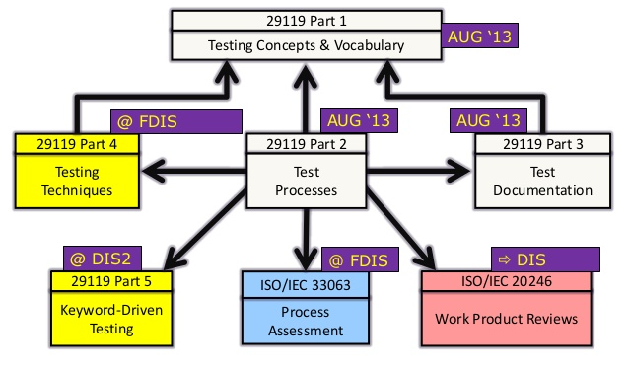
ISO/IEC 20246
ISO/IEC 20246 contains more in-depth descriptions of the review process for work products, including roles and review techniques.

Slide 6
Work Product Review Process
The review process comprises the following main activities:
Planning
Initiate review
Individual review (i.e., individual preparation)
Issue communication and analysis
Fixing and reporting

Slide 7
Work Product Review Process
Initiate review
Issue communication and analysis
Distributing issue log forms, checklists, and related work products
Explaining the scope, objectives, process, roles, and work products to the participants
Communicating identified potential defects
Analyzing potential defects, assigning ownership and status to them
Evaluating findings to reject/accept changes needed
1
2
3
4
5
Planning
Individual review
Fixing and reporting
Selecting the people to participate
Defining the scope
Estimating effort and timeframe
Identifying the review type with roles, activities, and checklists
Reviewing all or part of the work product
Noting potential defects, recommendations, and questions
Creating defect reports
Fixing defects found
Communicating defects to the appropriate person or team
Checking that exit criteria are met

Slide 8
Roles in a Formal Review
A typical formal review will include the roles below:
Author
Management
Facilitator (or moderator)
Review Leader
Reviewers
Scribe (or recorder)

Slide 9
Responsibilities in a formal review
Author
Creates the work product under review
Fixes defects in the work product under review (if necessary)
Management
Review planning & decides on the execution of reviews
Assigns staff, budget, and time
Monitors ongoing cost-effectiveness
Facilitator or
Moderator
Ensures effective running of review meetings (when held)
Mediates, if necessary, between the various points of view
Is often the person upon whom the success of the review depends
Review leader
Takes overall responsibility for the review
Decides who will be involved and organizes when and where it will take place
Reviewers
May be subject matter experts, persons working on the project, etc..
Identify potential defects in the work product under review
May represent different perspectives, e.g., tester, developer, user, etc.
Scribe
Collates potential defects found during the individual review activity
Records new potential defects, open points, and decisions from the review meeting (when held)

Slide 10
Review Types
The following lists the four most common types of reviews and their associated attributes:
Informal review
Buddy Check
Pairing
Pair Review
Walkthrough
Technical review
Inspection

Slide 11




Review Types
Informal
review
Walkthrough
Technical
Review
Inspection
Detecting potential defects
Find defects, improve the software product
Detecting potential defects
Gaining consensus
Detecting potential defects
Preventing future similar defects
Root cause analysis
Main Purpose
Additional Purposes
Generating new ideas or solutions
Quickly solving minor problems
Exchanging ideas about techniques
Training of participants
Achieving consensus
Evaluating quality and building confidence
Generating new ideas
Improve future work products
Achieving consensus
Not based on a formal process
May not involve a review meeting
Buddy check
Use of checklists is optional
Scribe is mandatory
Review meeting is typically led by the author
Reviewers should be technical peers of the author
Preparation before the review meeting is required
Scribe is mandatory
Review meeting is optional
Based on rules and Checklists
Clearly defined roles
Scribe is mandatory
Specified entry and exit criteria are used
Metrics are collected
More Info
about it
Less
FORMALITY
More

Slide 12
Review Techniques
Examples of different individual review techniques for various review types are listed below:
Ad hoc. Little or no guidance, little preparation.
Checklist-based. Based on checklists
Scenarios and dry runs. Based on expected usage
Perspective-based. Based on perspectives of different stakeholders
Role-based. Evaluation by different roles of stakeholders

Slide 13
Q & E

